Slide 1

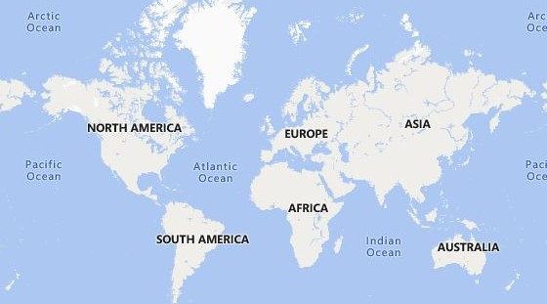

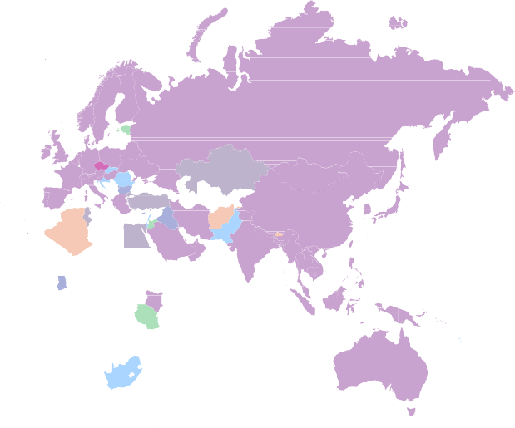
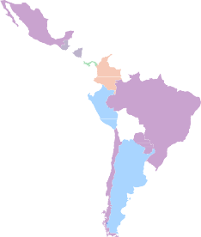

Sum of length_of_stay by flight_day
Power BI Desktop
Sum of num_passengers by flight_day and booking_complete
booking_co… 0 1
97K (9.04%)
134K (12.53%)
183K (17.05%)
flight_day
Mon
Tue Thu
Fri Sun Sat Wed
 booking_complete ×
Sum of num_passengers
12K
179K
(16.7%)
0
42522
10K
147K (13.74%)
Count of booking_…
50000
8K
158K (14.7%)
174K (16.24%)
1
7478
Mon Wed Tue Thu Sun
flight_day
Fri
Sat
booking_origin and flight_day
flight_day Fri Mon Sat Sun
Report
15% Of customers completes the booking ,85% don't. We need to work on that
Customer prefer to book Tickets on Monday >Tuesday>Thursday>Friday in this order
We need to Target people we book Tickets on Friday ,Coz those are the People Booking for HOLIDAYS
People who choose to go for Holidays usually stay for 3-6 Days
Australia, Malaysia, South Korea, Japan, China these are the top 4 market people choose to travel , so we need to Target these region mostly.
67% Of people opt for Extra baggage
57% of people Don't prefer in-Flight meals.
Thu Tue Wed
© 2023 TomTom,, © 2023 Miiccrrossofftt Corrporrattiion,, © OpenSttrreettMap

